Slide 1

Customer Segmentation for Online Retailing
Jun Tian
January 2021

Slide 2
Introduction
Background
- UK based online retailer of all occasion gifts
- Many customers are wholesales
- Customers are from various countries
- All transactions between 12/1/10 and 12/9/2011
- 541,909 records and 8 attributes in the dataset
Goals
- Better understanding customers
- To build a foundation for effective and differentiated marketing decisions

Slide 3
Customer Segmentation
Who are the major customers and where are they?
Any similarities among the customers with regard to geographical locations, favorable products, purchasing patterns and so on?
Who are the most/least loyal customers and what are their characteristics?
What are the most/least popular products?
Any there sales patterns in terms of products, time, region, and so on?
….

Slide 4
Data attributes
InvoiceNo: Invoice number. Nominal, a 6-digit integral number uniquely assigned to each transaction. If this code starts with letter 'c', it indicates a cancellation.
StockCode: Product (item) code. Nominal, a 5-digit integral number uniquely assigned to each distinct product.
Description: Product (item) name. Nominal.
Quantity: The quantities of each product (item) per transaction. Numeric.
InvoiceDate: Invoice Date and time. Numeric, the day and time when each transaction was generated.
UnitPrice: Unit price. Numeric, Product price per unit in sterling.
CustomerID: Customer number. Nominal, a 5-digit integral number uniquely assigned to each customer.
Country: Country name. Nominal, the name of the country where each customer resides

Slide 5
Method and Process
Data wrangling and preparation
Explanatory data analysis
RFM model
Recency
Frequency
Monetary-value
Clustering
Recommendations

Slide 6
Data Wrangling
Deleting Duplicates: 5,268 duplicated records
Missing Data: Discription – 1,454 missing data CustomerID – 135,037 missing data
Data Types
Anomalies and Outliers
Quantity: negative values; very large quantity
UnitPrice: zero values; very large UnitPrice
Description: handling and postages
StockCode: handling, postages, and bank charges
388,057 records remain in the clean dataset
Adding new features for analysis

Slide 7
Customers from 37 countries/regions

Slide 8
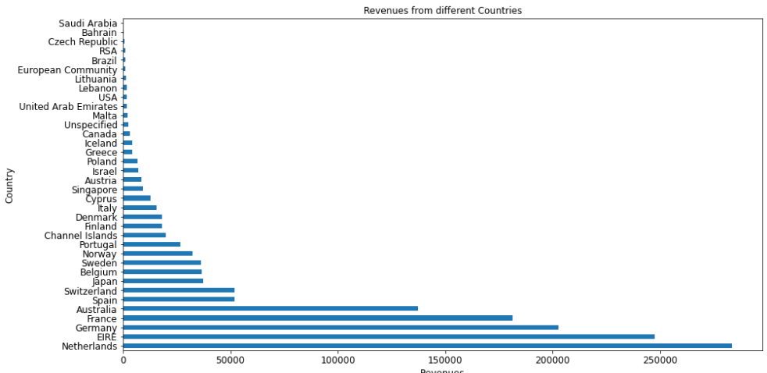

Slide 9
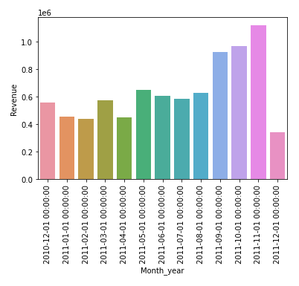

Slide 10
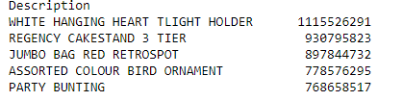
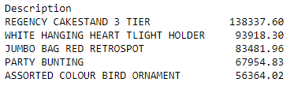
Most purchased Items
Most Profitable Items

Slide 11
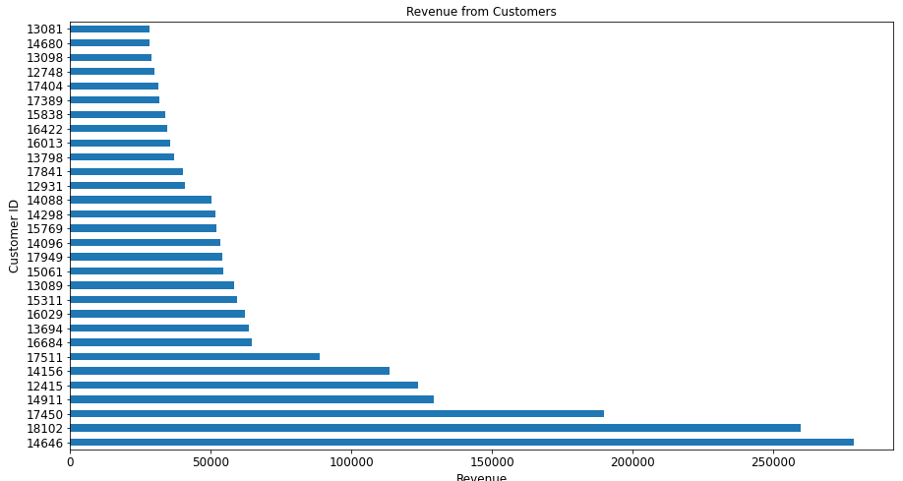

Slide 12
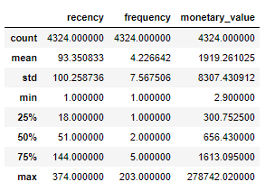
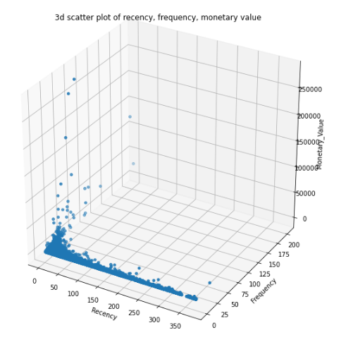
RFM Model

Slide 13
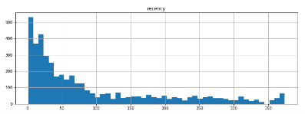
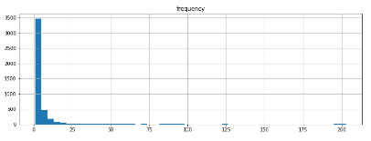
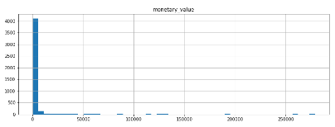

Slide 14
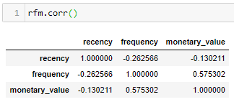
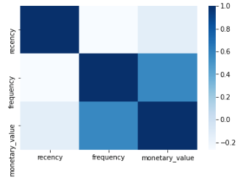

Slide 15
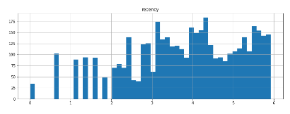
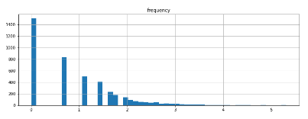
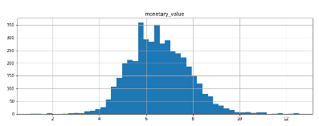
Log Transformation

Slide 16
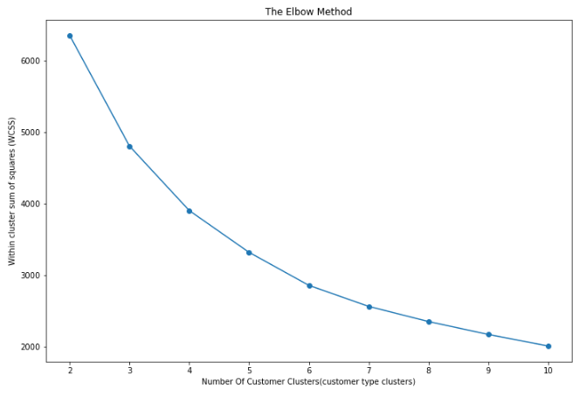

Slide 17
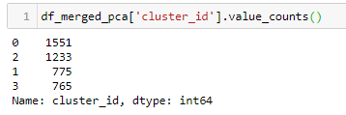
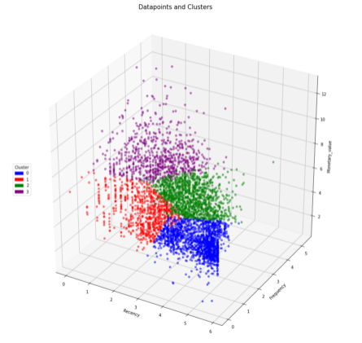

Slide 18
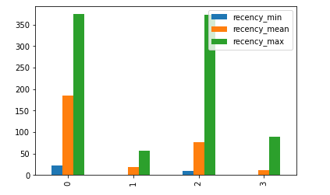
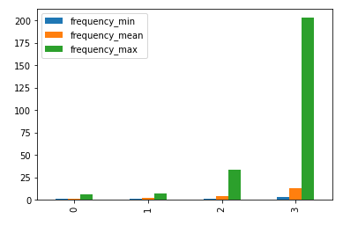
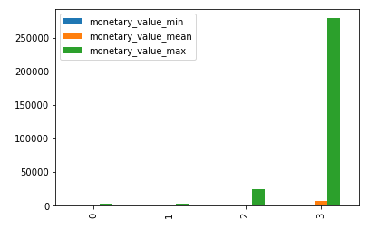

Slide 19
Recommendations
Differentiated marketing decisions
- cluster 1: old customers, not active for a long time
- cluster 2: old customers, last purchase was recent
- cluster 3: old customers, used to be active
- cluster 4: core value, very active
Exploring characteristics in each cluster in addition to RFM
Data for recent period and longer perioedpreferred
Keep complete record
- deleted transactions with missing CustomerIDs, which account for 24.9% of the total transaction, and might affect the model result

